Slide 1
Syntax Analysis
Parsing

Slide 2
PARSING:
It is the process of analyzing a continuous stream of input in order to determine its grammatical structure with respect to a given formal grammar.

Slide 3
Parse tree:
Graphical representation of a derivation or deduction is called a parse tree.
Each interior node of the parse tree is a non-terminal; the children of the node can be terminals or non-terminals.

Slide 4
Types of parsing:
Top down parsing
Bottom up parsing.
Top–down parsing: A parser can start with the start symbol and try to transform it to the input string. Example: LL Parsers.
Bottom–up parsing: A parser can start with input and attempt to rewrite it into the start symbol. Example: LR Parsers.

Slide 5
TOP-DOWN PARSING:
It can be viewed as an attempt to find a left-most derivation for an input string or an attempt to construct a parse tree for the input starting from the root to the leaves.
Types of top-down parsing:
Recursive descent parsing
Non-Recursive descent parsing/ Predictive parsing

Slide 6
RECURSIVE DESCENT PARSING:
Recursive descent parsing is one of the top-down parsing techniques that uses a set of recursive procedures to scan its input.
This parsing method may involve backtracking, that is, making repeated scans of the input.
Example for backtracking: Consider the grammar G:
S → cAd
A → ab | a
and the input string w=cad.

Slide 7
Example for recursive decent parsing:
Consider the grammar
DATATYPE→ SIMPLE | ↑id | array[SIMPLE] of DATATYPE
SIMPLE → integer | char | num dot dot num

Slide 8
Example for recursive decent parsing:
The Procedure for each non-terminal is defined as follows:
Procedure match(t: token)
begin
if lookahead = t then
lookahead:= next token
else
error
end;

Slide 9
Example for recursive decent parsing:
The Procedure for each non-terminal is defined as follows:
Procedure DATATYPE
begin
if lookahead is in { integer, char, num} then
call(SIMPLE)
else if lookahead = ‘↑’ then
begin
match(‘↑’); match(id)
end;
else if lookahead = ‘array’ then begin
match(array); match(‘[’); call(SIMPLE);
match(‘]’); match(‘of’); call(DATATYPE);
end
else
error
End;

Slide 10
Example for recursive decent parsing:
Procedure SIMPLE;
Begin
if lookahead = integerr then
match(integer);
else if lookahead = char then
match(char);
else if lookahead = num then
begin
match(num); match(dotdot); match(num);
end
else
error
end

Slide 11
Example for recursive decent parsing:
A left-recursive grammar can cause a recursive-descent parser to go into an infinite loop.
Hence, elimination of left-recursion must be done before parsing.
Consider the grammar for arithmetic expressions
E → E+T | T
T → T*F | F
F → (E) | id

Slide 12
Example for recursive decent parsing:
After eliminating the left-recursion the grammar becomes,
E → TE’
E’ → +TE’ | ε
T → FT’
T’ → *FT’ | ε
F → (E) | id

Slide 13
Recursive Decent Parser:
Procedure E()
begin T();
EPRIME( );
End
Procedure EPRIME( )
begin If input_symbol=’+’ then ADVANCE( );
T( );
EPRIME( );
end
end

Slide 14
Recursive Decent Parser:
Procedure T( )
begin
F( );
TPRIME( );
end
Procedure TPRIME( )
begin
If input_symbol=’*’ then ADVANCE( );
F( );
TPRIME( );
end
Procedure F( )
begin
If input_symbol=’id’ then ADVANCE( );
else if input-symbol=’(‘ then ADVANCE( );
E( );
else if input_symbol=’)’ then ADVANCE( );
else ERROR( );
end

Slide 15
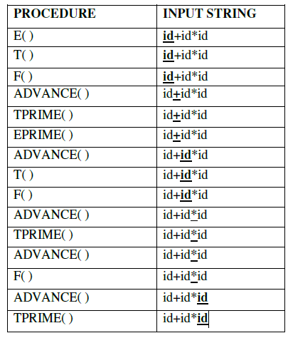
Stack implementation:

Slide 16
PREDICTIVE PARSING:
Predictive parsing is a special case of recursive descent parsing where no backtracking is required.
The key problem of predictive parsing is to determine the production to be applied for a non-terminal in case of alternatives.

Slide 17
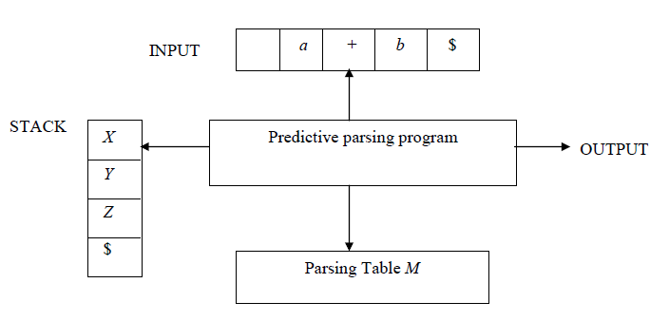
Non-recursive predictive parser:

Slide 18
Non-recursive predictive parser:
Input buffer: It consists of strings to be parsed, followed by $ to indicate the end of the input string.
Stack: It contains a sequence of grammar symbols preceded by $ to indicate the bottom of the stack.
Initially, the stack contains the start symbol on top of $.
Parsing table: It is a two-dimensional array M[A, a], where ‘A’ is a non-terminal and ‘a’ is a terminal.

Slide 19
Predictive parsing program:
The parser is controlled by a program that considers X, the symbol on top of stack, and a, the current input symbol.
If X = a = $, the parser halts and announces successful completion of parsing.
If X = a ≠ $, the parser pops X off the stack and advances the input pointer to the next input symbol.
If X is a non-terminal , the program consults entry M[X, a] of the parsing table M. This entry will either be an X-production of the grammar or an error entry.
If M[X, a] = {X → UVW},the parser replaces X on top of the stack by UVW
If M[X, a] = error, the parser calls an error recovery routine.

Slide 20
Algorithm for construction of predictive parsing table:
Input : Grammar G
Output : Parsing table M
Method :
1. For each production A → α of the grammar, do steps 2 and 3.
2. For each terminal ‘a’ in FIRST(α), add A → α to M[A, a].
3. If ε is in FIRST(α), add A → α to M[A, b] for each terminal b in FOLLOW(A). If ε is in FIRST(α) and $ is in FOLLOW(A) , add A → α to M[A, $].
4. Make each undefined entry of M be error.

Slide 21
Construction of predictive parsing table:
Example:
Consider the following grammar :
E → E+T | T
T → T*F | F
F → (E) | id
After eliminating left-recursion the grammar is
E → TE’
E’ → +TE’ | ε
T → FT’
T’ → *FT’ | ε
F → (E) | id

Slide 22
Construction of predictive parsing table:
First( ) :
FIRST(E) = { ( , id}
FIRST(E’) ={+ , ε }
FIRST(T) = { ( , id}
FIRST(T’) = {*, ε }
FIRST(F) = { ( , id }
Follow( ):
FOLLOW(E) = { $, ) }
FOLLOW(E’) = { $, ) }
FOLLOW(T) = { +, $, ) }
FOLLOW(T’) = { +, $, ) }
FOLLOW(F) = {+, * , $ , ) }

Slide 23
Construction of predictive parsing table:
Non-Terminals | Terminals
 | id | + | * | ( | ) | $
E
E’
T
T’
F

Slide 24
Construction of predictive parsing table:
Non-Terminals | Terminals
 | id | + | * | ( | ) | $
E | E → TE’ |  |  | E → TE’
E’
T
T’
F

Slide 25
Construction of predictive parsing table:
Non-Terminals | Terminals
 | id | + | * | ( | ) | $
E | E → TE’ |  |  | E → TE’
E’ |  | E’ → +TE’
T
T’
F

Slide 26
Construction of predictive parsing table:
Non-Terminals | Terminals
 | id | + | * | ( | ) | $
E | E → TE’ |  |  | E → TE’
E’ |  | E’ → +TE’ |  |  | E’ → ε | E’ → ε
T
T’
F

Slide 27
Construction of predictive parsing table:
Non-Terminals | Terminals
 | id | + | * | ( | ) | $
E | E → TE’ |  |  | E → TE’
E’ |  | E’ → +TE’ |  |  | E’ → ε | E’ → ε
T | T → FT’ |  |  | T → FT’
T’
F

Slide 28
Construction of predictive parsing table:
Non-Terminals | Terminals
 | id | + | * | ( | ) | $
E | E → TE’ |  |  | E → TE’
E’ |  | E’ → +TE’ |  |  | E’ → ε | E’ → ε
T | T → FT’ |  |  | T → FT’
T’ |  |  | T’ → *FT’
F

Slide 29
Construction of predictive parsing table:
Non-Terminals | Terminals
 | id | + | * | ( | ) | $
E | E → TE’ |  |  | E → TE’
E’ |  | E’ → +TE’ |  |  | E’ → ε | E’ → ε
T | T → FT’ |  |  | T → FT’
T’ |  | T’ → ε | T’ → *FT’ |  | T’ → ε | T’ → ε
F

Slide 30
Construction of predictive parsing table:
Non-Terminals | Terminals
 | id | + | * | ( | ) | $
E | E → TE’ |  |  | E → TE’
E’ |  | E’ → +TE’ |  |  | E’ → ε | E’ → ε
T | T → FT’ |  |  | T → FT’
T’ |  | T’ → ε | T’ → *FT’ |  | T’ → ε | T’ → ε
F | F → id |  |  | F → (E)

Slide 31
Stack implementation:

Slide 32
STACK | INPUT | OUTPUT
$E | id+id*id $

Slide 33
STACK | INPUT | OUTPUT
$E | id+id*id $

Slide 34
STACK | INPUT | OUTPUT
$E | id+id*id $
$E’T | id+id*id $ | E → TE’

Slide 35
STACK | INPUT | OUTPUT
$E | id+id*id $
$E’T | id+id*id $ | E → TE’

Slide 36
STACK | INPUT | OUTPUT
$E | id+id*id $
$E’T | id+id*id $ | E → TE’
$E’T’F | id+id*id $ | T → FT’

Slide 37
STACK | INPUT | OUTPUT
$E | id+id*id $
$E’T | id+id*id $ | E → TE’
$E’T’F | id+id*id $ | T → FT’

Slide 38
STACK | INPUT | OUTPUT
$E | id+id*id $
$E’T | id+id*id $ | E → TE’
$E’T’F | id+id*id $ | T → FT’
$E’T’id | id+id*id $ | F → id

Slide 39
STACK | INPUT | OUTPUT
$E | id+id*id $
$E’T | id+id*id $ | E → TE’
$E’T’F | id+id*id $ | T → FT’
$E’T’id | id+id*id $ | F → id

Slide 40
STACK | INPUT | OUTPUT
$E | id+id*id $
$E’T | id+id*id $ | E → TE’
$E’T’F | id+id*id $ | T → FT’
$E’T’id | id+id*id $ | F → id
$E’T’ | +id*id $

Slide 41
STACK | INPUT | OUTPUT
$E | id+id*id $
$E’T | id+id*id $ | E → TE’
$E’T’F | id+id*id $ | T → FT’
$E’T’id | id+id*id $ | F → id
$E’T’ | +id*id $
$E’ | +id*id $ | T’ → ε

Slide 42
STACK | INPUT | OUTPUT
$E | id+id*id $
$E’T | id+id*id $ | E → TE’
$E’T’F | id+id*id $ | T → FT’
$E’T’id | id+id*id $ | F → id
$E’T’ | +id*id $
$E’ | +id*id $ | T’ → ε
$E’T+ | +id*id $ | E’ → +TE’

Slide 43
STACK | INPUT | OUTPUT
$E | id+id*id $
$E’T | id+id*id $ | E → TE’
$E’T’F | id+id*id $ | T → FT’
$E’T’id | id+id*id $ | F → id
$E’T’ | +id*id $
$E’ | +id*id $ | T’ → ε
$E’T+ | +id*id $ | E’ → +TE’
$E’T | id*id $

Slide 44
STACK | INPUT | OUTPUT
$E | id+id*id $
$E’T | id+id*id $ | E → TE’
$E’T’F | id+id*id $ | T → FT’
$E’T’id | id+id*id $ | F → id
$E’T’ | +id*id $
$E’ | +id*id $ | T’ → ε
$E’T+ | +id*id $ | E’ → +TE’
$E’T | id*id $
$E’T’F | id*id $ | T → FT’

Slide 45
STACK | INPUT | OUTPUT
$E | id+id*id $
$E’T | id+id*id $ | E → TE’
$E’T’F | id+id*id $ | T → FT’
$E’T’id | id+id*id $ | F → id
$E’T’ | +id*id $
$E’ | +id*id $ | T’ → ε
$E’T+ | +id*id $ | E’ → +TE’
$E’T | id*id $
$E’T’F | id*id $ | T → FT’
$E’T’id | id*id $ | F → id

Slide 46
STACK | INPUT | OUTPUT
$E | id+id*id $
$E’T | id+id*id $ | E → TE’
$E’T’F | id+id*id $ | T → FT’
$E’T’id | id+id*id $ | F → id
$E’T’ | +id*id $
$E’ | +id*id $ | T’ → ε
$E’T+ | +id*id $ | E’ → +TE’
$E’T | id*id $
$E’T’F | id*id $ | T → FT’
$E’T’id | id*id $ | F → id
$E’T’ | *id $

Slide 47
STACK | INPUT | OUTPUT
$E | id+id*id $
$E’T | id+id*id $ | E → TE’
$E’T’F | id+id*id $ | T → FT’
$E’T’id | id+id*id $ | F → id
$E’T’ | +id*id $
$E’ | +id*id $ | T’ → ε
$E’T+ | +id*id $ | E’ → +TE’
$E’T | id*id $
$E’T’F | id*id $ | T → FT’
$E’T’id | id*id $ | F → id
$E’T’ | *id $
$E’T’F* | *id $ | T’ → *FT’

Slide 48
STACK | INPUT | OUTPUT
$E | id+id*id $
$E’T | id+id*id $ | E → TE’
$E’T’F | id+id*id $ | T → FT’
$E’T’id | id+id*id $ | F → id
$E’T’ | +id*id $
$E’ | +id*id $ | T’ → ε
$E’T+ | +id*id $ | E’ → +TE’
$E’T | id*id $
$E’T’F | id*id $ | T → FT’
$E’T’id | id*id $ | F → id
$E’T’ | *id $
$E’T’F* | *id $ | T’ → *FT’
$E’T’F | id $

Slide 49
STACK | INPUT | OUTPUT
$E | id+id*id $
$E’T | id+id*id $ | E → TE’
$E’T’F | id+id*id $ | T → FT’
$E’T’id | id+id*id $ | F → id
$E’T’ | +id*id $
$E’ | +id*id $ | T’ → ε
$E’T+ | +id*id $ | E’ → +TE’
$E’T | id*id $
$E’T’F | id*id $ | T → FT’
$E’T’id | id*id $ | F → id
$E’T’ | *id $
$E’T’F* | *id $ | T’ → *FT’
$E’T’F | id $
$E’T’id | id $ | F → id

Slide 50
STACK | INPUT | OUTPUT
$E | id+id*id $
$E’T | id+id*id $ | E → TE’
$E’T’F | id+id*id $ | T → FT’
$E’T’id | id+id*id $ | F → id
$E’T’ | +id*id $
$E’ | +id*id $ | T’ → ε
$E’T+ | +id*id $ | E’ → +TE’
$E’T | id*id $
$E’T’F | id*id $ | T → FT’
$E’T’id | id*id $ | F → id
$E’T’ | *id $
$E’T’F* | *id $ | T’ → *FT’
$E’T’F | id $
$E’T’id | id $ | F → id
$E’T’ | $

Slide 51
STACK | INPUT | OUTPUT
$E | id+id*id $
$E’T | id+id*id $ | E → TE’
$E’T’F | id+id*id $ | T → FT’
$E’T’id | id+id*id $ | F → id
$E’T’ | +id*id $
$E’ | +id*id $ | T’ → ε
$E’T+ | +id*id $ | E’ → +TE’
$E’T | id*id $
$E’T’F | id*id $ | T → FT’
$E’T’id | id*id $ | F → id
$E’T’ | *id $
$E’T’F* | *id $ | T’ → *FT’
$E’T’F | id $
$E’T’id | id $ | F → id
$E’T’ | $
$E’ | $ | T’ → ε

Slide 52
STACK | INPUT | OUTPUT
$E | id+id*id $
$E’T | id+id*id $ | E → TE’
$E’T’F | id+id*id $ | T → FT’
$E’T’id | id+id*id $ | F → id
$E’T’ | +id*id $
$E’ | +id*id $ | T’ → ε
$E’T+ | +id*id $ | E’ → +TE’
$E’T | id*id $
$E’T’F | id*id $ | T → FT’
$E’T’id | id*id $ | F → id
$E’T’ | *id $
$E’T’F* | *id $ | T’ → *FT’
$E’T’F | id $
$E’T’id | id $ | F → id
$E’T’ | $
$E’ | $ | T’ → ε
$ | $ | E’ → ε

Slide 53
Construction of predictive parsing table: Not LL(1)
Given grammar R→R/R | RR | R* | (R) | a | b
Eliminate Left Recursion from the given grammar
After eliminating Left Recursion:
R→(R)R’ |aR’ | bR’
R’→ /RR’ | RR’ | *R’ | ε

Slide 54
Construction of predictive parsing table:
Construct First & Follow:
First:
First(R)={(, a, b}
First(R’)={/, (, a, b, *, ε}
Follow:
Follow(R)={$, ), /, (, a, b, *}
Follow(R’)={$, ), /, (, a, b, *}

Slide 55
Construction of predictive parsing table:
Non-Terminals | Terminals
 | a | b | * | / | ( | ) | $
R | R→aR’ | R→bR’ |  |  | R→(R)R’
R’ | R’→RR’ R’→ε | R’→RR’ R’→ε | R’→*R’ R’→ε | R’→/RR’ R’→ε | R’→RR’ R’→ε | R’→ε | R’→ε

Slide 56
Bottom Up Parsing:
Bottom-up parsing starts from the leaf nodes of a tree and works in upward direction till it reaches the root node.
Here, we start from a sentence and then apply production rules in reverse manner in order to reach the start symbol.

Slide 57
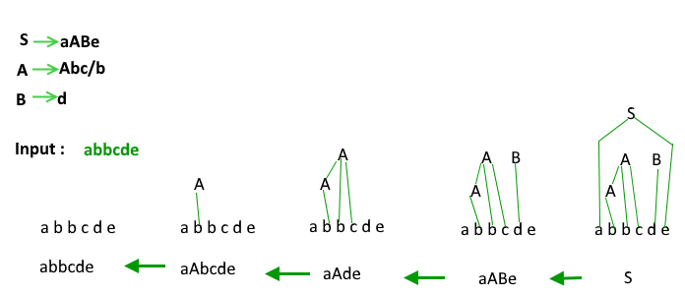
Bottom Up Parsing:

Slide 58
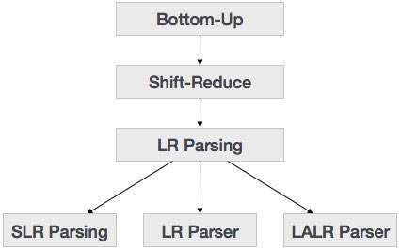
Bottom Up Parsing:

Slide 59
Bottom Up Parsing:
Handle:
Handle of a string is a substring that matches the right side of a production and which can be reduced to the non-terminal on the left side of the production.
Handle Pruning:
The process of reducing the string to the starting symbol is called handle pruning.
A right most derivation in reverse can be obtained by handle pruning.

Slide 60
Handle Pruning:
S→ aABe
A→ Abc | b
B→d
String: abbcde

Slide 61
Shift Reduce Parser:
A shift reduce parser consists of four actions.
Shift: Next input symbol is shifted onto the top of the stack
Reduce: The element on top of the stack is reduced to the non-terminal on the left side of the production.
Accept: Announces successful completion of parsing.
Error: Discovers that a syntax error has occurred and calls error recovery routine.

Slide 62
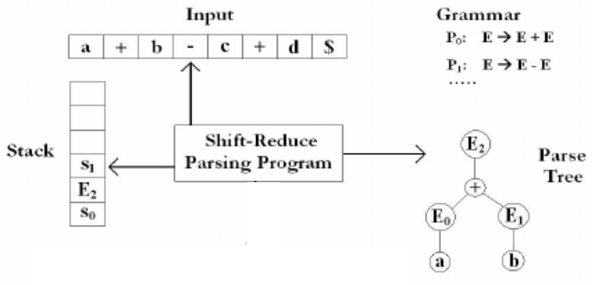
Shift Reduce Parser:

Slide 63
Shift Reduce Parser:
E→E+T | T
T→ T*F | F
F→ (E) | id
Input String: id*id+id

Slide 64
LR Parsers:
LR Parsing is a bottom up parsing technique which can be used to parse a larger class of CFG.
The technique of parsing is called as LR(K) parsing.
Where ‘L’ stands for left to right scanning of the input.
‘R’ – right most derivation in reverse.
‘K’ – number of input symbols of lookahead used in making parsing decisions.
If K is not specified it is assumed to be 1.

Slide 65
LR Parsers:
The three representatives of this family are
SLR- Simple LR
LR – Canonical LR
LALR – Lookahead LR

Slide 66
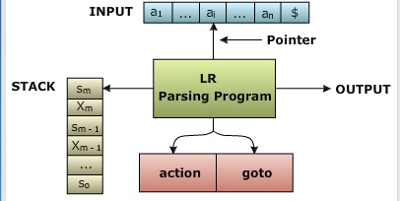
Structure of a LR Parser:

Slide 67
LR Parsing Program:
Input: An input string w and LR parsing table with function action and goto for a grammar G.
Method:
Let S be the state on top of the stack and a the symbol pointed by ip.
if action[S, a] =shift S’ then begin
Push a then S’ on top of the stack;
advance ip to the next input symbol
end
else if action[S, a]= reduce A→ ß then begin
pop 2*| ß | symbols off the stack;
let S’ be the state now on top of the stack;
push A then goto[S’, A] on top of the stack;
output the production A→ ß;
end
else if action[S, a]= accept then return
else error()
end

